Slide 1
HTML Layouting and Semantic Structure

Slide 2
Objective: Why study HTML structure
HTML has a dual structure
Layout Elements: Information about layouting such as DOM as % of width. Examples: <div> and <span> - Tells nothing about its content.
Semantic elements: <form>, <table>, and <article> - Clearly defines its content.
Sometimes they contradict
Need to understand the layouting process to decide what is the model-independent unit of representation of webpage, to get features for reading view ML algo
Second problem: How to change reading view when resized?

Slide 3

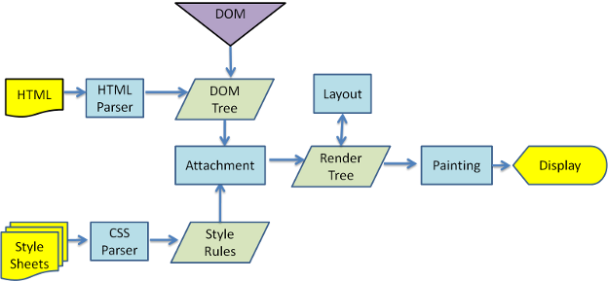
Browser main flow
http://taligarsiel.com/Projects/howbrowserswork1.htm

Slide 4
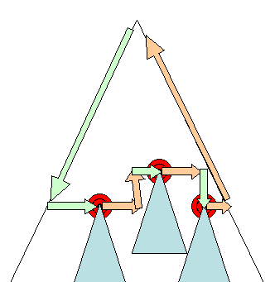
How layout works
http://taligarsiel.com/Projects/howbrowserswork1.htm#layout
When the renderer is created and added to the tree, it does not have a position and size. Calculating these values is called layout or reflow.
HTML uses a flow based layout model, meaning that most of the time it is possible to compute the geometry in a single pass. Elements later ``in the flow'' typically do not affect the geometry of elements that are earlier ``in the flow'', so layout can proceed left-to-right, top-to-bottom through the document. There are exceptions - for example, HTML tables may require more than one pass (3.5).
The coordinate system is relative to the root frame. Top and left coordinates are used.
Layout is a recursive process. It begins at the root renderer, which corresponds to the element of the HTML document. Layout continues recursively through some or all of the frame hierarchy, computing geometric information for each renderer that requires it.
The position of the root renderer is 0,0 and its dimensions is the viewport - the visible part of the browser window.All renderers have a "layout" or "reflow" method, each renderer invokes the layout method of its children that need layout.

Slide 5
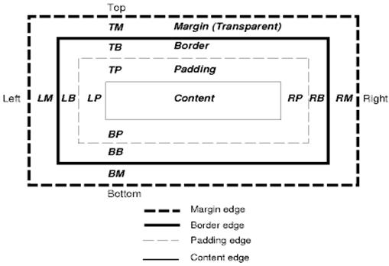
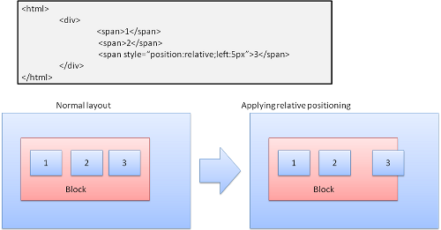
Layout process
http://taligarsiel.com/Projects/howbrowserswork1.htm#layout and https://dbaron.org/talks/2008-11-12-faster-html-and-css/slide-6.xhtml
The layout usually has the following pattern:
Parent renderer determines its own width.
Parent goes over children and:
Place the child renderer (sets its x and y).
Calls child layout if needed(they are dirty or we are in a global layout or some other reason) - this calculates the child's height.
Parent uses children accumulative heights and the heights of the margins and paddings to set it own height - this will be used by the parent renderer's parent.
Sets its dirty bit to false.
Firefox uses a "state" object(nsHTMLReflowState) as a parameter to layout (termed "reflow"). Among others the state includes the parents width. The output of Firefox layout is a "metrics" object(nsHTMLReflowMetrics). It will contain the renderer computed height.
The CSS box model describes the rectangular boxes that are generated for elements in the document tree and laid out according to the visual formatting model. Each box has a content area (e.g., text, an image, etc.) and optional surrounding padding, border, and margin areas. Each node generates 0..n such boxes.
Layered representation
It is specified by the z-index CSS property. It represents the 3rd dimension of the box, its position along the "z axis".
The boxes are divided to stacks (called stacking contexts). In each stack the back elements will be painted first and the forward elements on top, closer to the user. In case of overlap the will hide the former element. The stacks are ordered according to the z-index property. Boxes with "z-index" property form a local stack. The viewport has the outer stack.

Slide 6
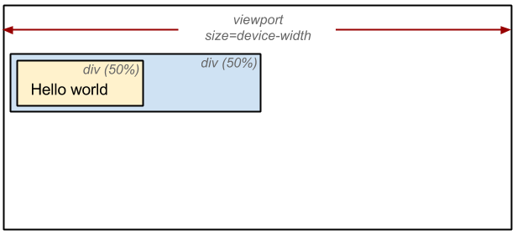
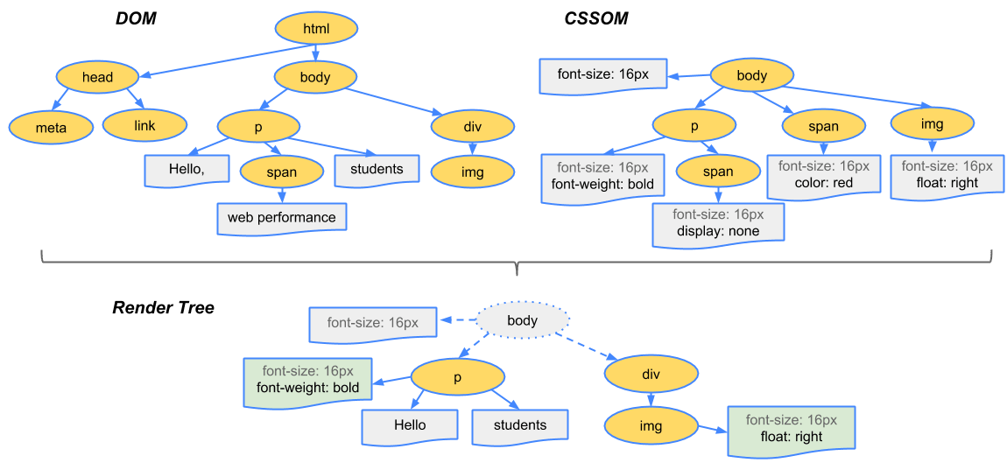
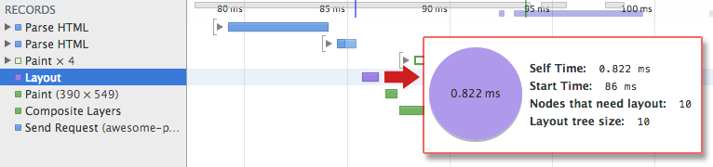
Render tree construction
https://developers.google.com/web/fundamentals/performance/critical-rendering-path/render-tree-construction
To construct the render tree, the browser roughly does the following:
Starting at the root of the DOM tree, traverse each visible node.
Some nodes are not visible (for example, script tags, meta tags, and so on), and are omitted since they are not reflected in the rendered output.
Some nodes are hidden via CSS and are also omitted from the render tree; for example, the span node---in the example above---is missing from the render tree because we have an explicit rule that sets the "display: none" property on it.
For each visible node, find the appropriate matching CSSOM rules and apply them.
Emit visible nodes with content and their computed styles.
Layout Process
The final output is a render that contains both the content and style information of all the visible content on the screen. With the render tree in place, we can proceed to the "layout" stage.
Up to this point we've calculated which nodes should be visible and their computed styles, but we have not calculated their exact position and size within the viewport of the device---that's the "layout" stage, also known as "reflow."
To figure out the exact size and position of each object on the page, the browser begins at the root of the render tree and traverses it.
Painting or rasterizing
The output of the layout process is a "box model," which precisely captures the exact position and size of each element within the viewport: all of the relative measurements are converted to absolute pixels on the screen.
Finally, now that we know which nodes are visible, and their computed styles and geometry, we can pass this information to the final stage, which converts each node in the render tree to actual pixels on the screen. This step is often referred to as "painting" or "rasterizing."

Slide 7
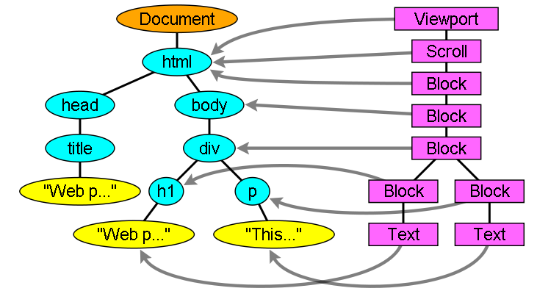
Browser Internals
https://www.html5rocks.com/en/tutorials/internals/howbrowserswork/
Render tree construction
While the DOM tree is being constructed, the browser constructs another tree, the render tree. This tree is of visual elements in the order in which they will be displayed. It is the visual representation of the document. The purpose of this tree is to enable painting the contents in their correct order.
Firefox calls the elements in the render tree "frames". WebKit uses the term renderer or render object. A renderer knows how to lay out and paint itself and its children.
The render tree relation to the DOM tree
The renderers correspond to DOM elements, but the relation is not one to one. Non-visual DOM elements will not be inserted in the render tree. An example is the "head" element. Also elements whose display value was assigned to "none" will not appear in the tree (whereas elements with "hidden" visibility will appear in the tree).

Slide 8
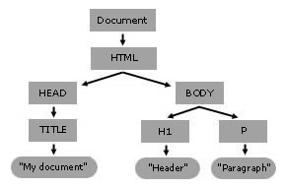
A good HTML skeleton
https://stackoverflow.com/questions/4134019/a-good-html-skeleton and https://developer.mozilla.org/en-US/docs/Web/API/Document_object_model/Using_the_W3C_DOM_Level_1_Core and W3C DOM level 1 spec https://www.w3.org/TR/REC-DOM-Level-1/level-one-core.html
<!DOCTYPE html>
<html dir="ltr" lang="en">
<head>
<meta charset="utf-8">
<title>Example</title>
<link rel="stylesheet" href="/default.css">
<link rel="icon" href="/favicon.png" sizes="16x16" type="image/png">
<link rel="canonical" href="http://example.com/">
<meta name="description" content="…">
</head>
<body>
<header>
<!-- site-wide header -->
<h1>Example <!-- site name --></h1>
</header>
<main>
<!-- this page’s main content -->
</main>
<nav>
<!-- site-wide navigation -->
</nav>
<footer>
<!-- site-wide footer -->
</footer>
</body>
</html>

Slide 9
DIV and SPAN
http://www.htmldog.com/guides/html/intermediate/spandiv/ and https://www.w3schools.com/Html/html_blocks.asp
HTML is all about applying meaning to content. Whereas most HTML tags apply meaning (p makes a paragraph, h1 makes a heading etc.), the span and div tags apply no meaning at all. This might sound about as useful as a foam hammer but they are actually used quite extensively in conjunction with CSS.
They are used to group together a chunk of HTML and hook some information onto that chunk, most commonly with the attributes class and id to associate the element with a class or id CSS selector.
The difference between span and div is that a span element is in-line and usually used for a small chunk of HTML inside a line (such as inside a paragraph) whereas a div (division) element is block-line (which is basically equivalent to having a line-break before and after it) and used to group larger chunks of code.
Block-level Elements: A block-level element always starts on a new line and takes up the full width available (stretches out to the left and right as far as it can). The <div> element is a block-level element.
Inline Elements: An inline element does not start on a new line and only takes up as much width as necessary. This is an inline <span> element inside a paragraph.
<div id="scissors">
<p>
This is <span class="paper">crazy</span>
</p>
</div>

Slide 10


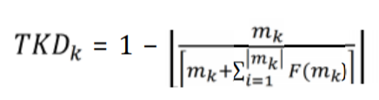
Problem with using only structural HTML tags for Boilerplate removal
Paper BOILERPLATE REMOVAL AND CONTENT EXTRACTION FROM DYNAMIC WEB PAGES by Pan Ei San
Usually, apart from the main content blocks, web pages usually have such blocks as navigation bars, copyright and privacy notices, relevant hyperlinks, and advertisements, which are called noisy blocks.
Modern web pages have largely abandoned the use of structural tags within a web page and adopted an architecture which makes use of style sheets and <div> or <span> tags for structural information.
Most current content extraction techniques make use of particular HTML cues such as tables, fonts, size and line, etc., and since modern web pages no longer include these cues, many content extraction algorithms have begun to perform poorly.
Features:
Tag to Text ratio
AnchorText to Text ratio
Title Keyword Density

Slide 11
Paper on GoldMiner Algo: enhancement to Boilerpipe
http://www.scielo.org.mx/pdf/poli/n48/n48a11.pdf
Merit of the boilerpipe [2] algorithm
Boilerplate content can be identified effectively by using a good combination of simple text properties.
They used an annotated training corpus of 500 documents (mainly Google news) to find the most effective feature combination.
They tried to extract articles with the help of shallow text features, using 8-10 different feature combinations, and then they evaluated their results. In their experiments, a combination of word and link density features gave the best results (its F-measure was: 92%).
Furthermore, the method is very fast and it needs no preprocessing. Both the training set and the tool can be downloaded.
CleanEval test set: https://github.com/ppke-nlpg/CleanPortalEval and https://cleaneval.sigwac.org.uk/devset.html
Mozilla Readability test dataset: https://github.com/mozilla/readability

Slide 12
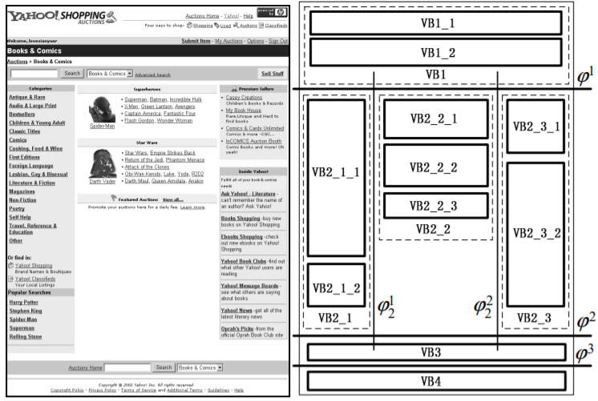
Paper on HTML layouts
http://www.dbs.ifi.lmu.de/~spyu/paper/VIPS-APWeb.pdf

Slide 13
Lowering predict threshold in scikit-learn
https://stackoverflow.com/questions/19984957/scikit-predict-default-threshold
Objective is to make sure no relevant text is left out, even if some ads etc noise creep in the reading view
The threshold in scikit learn is 0.5 for binary classification and whichever class has the greatest probability for multiclass classification. In many problems a much better result may be obtained by adjusting the threshold. However, this must be done with care and NOT on the holdout test data but by cross validation on the training data. If you do any adjustment of the threshold on your test data you are just overfitting the test data.
Most methods of adjusting the threshold is based on the receiver operating characteristics (ROC) and Youden's J statistic but it can also be done by other methods such as a search with a genetic algorithm.
Scikit-learn uses LibSVM internally, and this in turn uses Platt scaling, as detailed in a note by the LibSVM authors, to calibrate the SVM to produce probabilities in addition to class predictions. Platt scaling requires first training the SVM as usual, then optimizing parameter vectors A and B such that P(y|X) = 1 / (1 + exp(A * f(X) + B))
from sklearn.tree import DecisionTreeClassifier clf = DecisionTreeClassifier(random_state = 2) clf.fit(X_train,y_train) # y_pred = clf.predict(X_test) # default threshold is 0.5 y_pred = (clf.predict_proba(X_test)[:,1] >= 0.3).astype(bool) # set threshold as 0.3

